Slide 1
Developer Exchange Group
深入淺出設計模式#3:
裝飾者模式
Prepare by Sean Hsieh

Slide 2
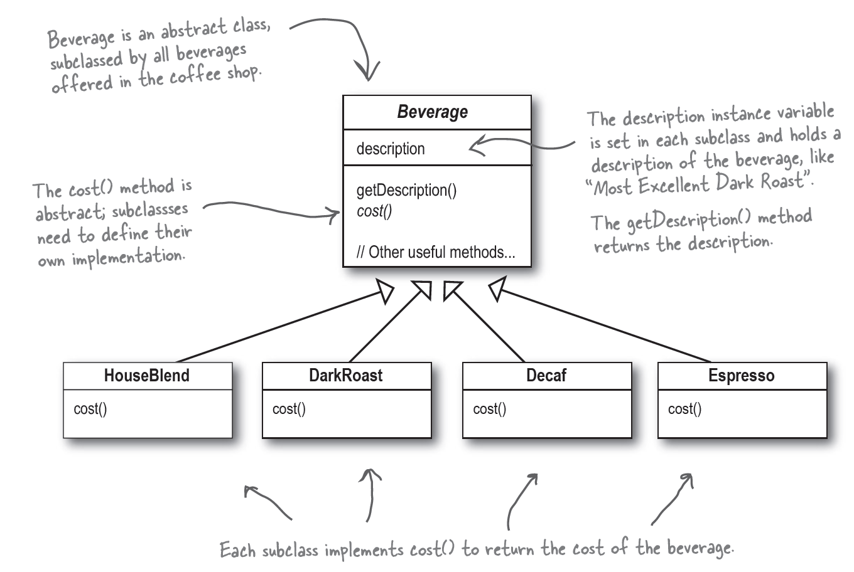
Scene
A coffee shop menu

Slide 3
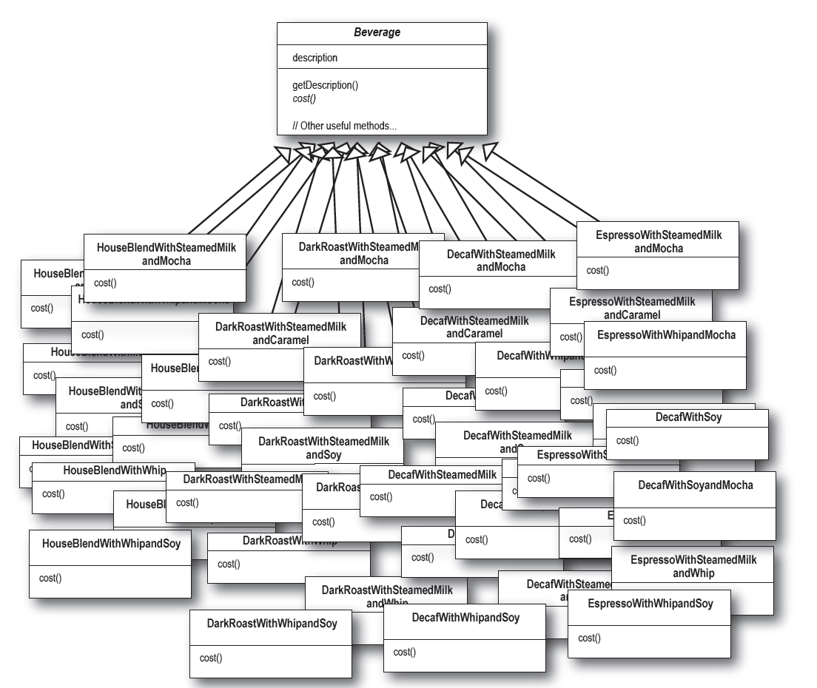
But we have many flavor of beverage…

Slide 4
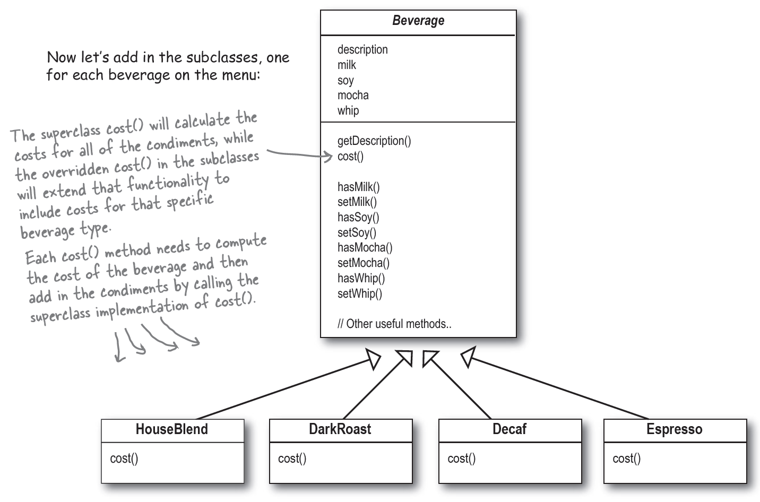
Let’s try to solve the problem
use instance variables and inheritance in the superclass to keep track of the condiments
But if we have new condiment?

Slide 5
The Open-Closed Principle
1. Classes should be open for extension, but closed for modification.
2. By dynamically composing objects, We can add new functionality by writing new code rather than altering existing code.

Slide 6
So how to design better?

Slide 7
Use Decorator pattern
Decorators + Components
Decorator
Component

Slide 8
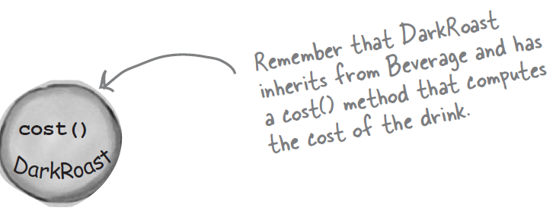
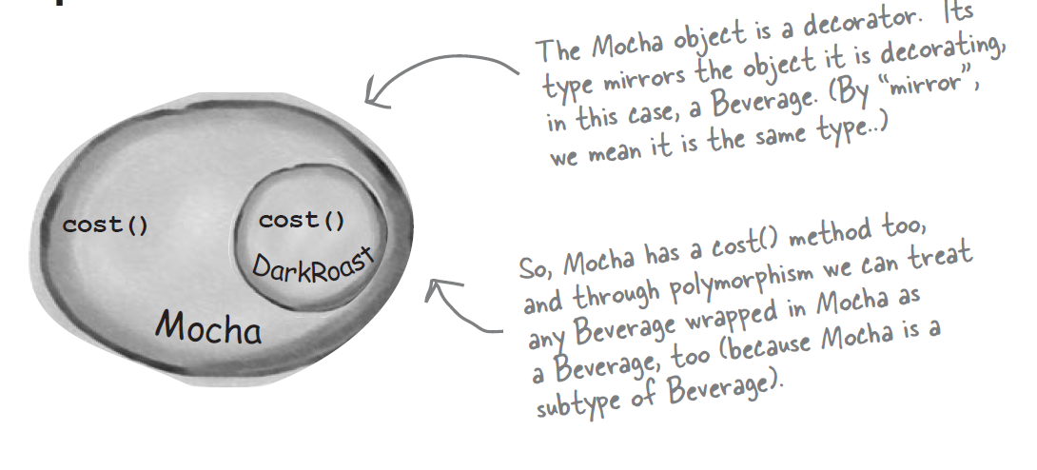
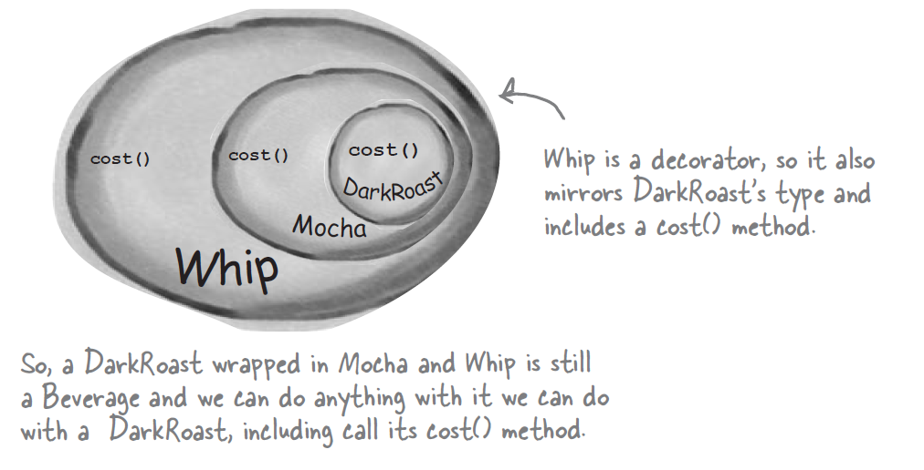
About Decorator pattern
1. We start with our DarkRoast object.
2. The customer wants Mocha, so we create a Mocha object and wrap it around the DarkRoast.
3. The customer also wants Whip, so we create a
Whip decorator and wrap Mocha with it.

Slide 9
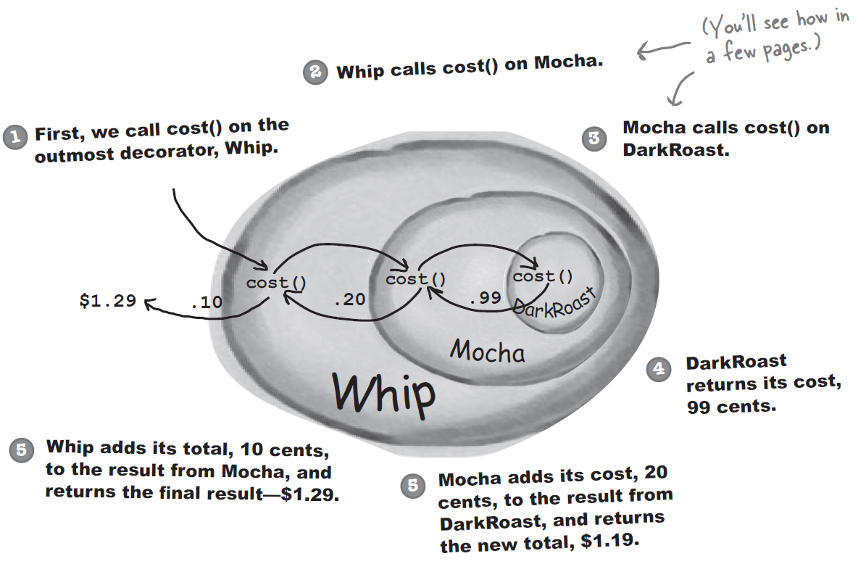
About Decorator pattern (cont.)

Slide 10
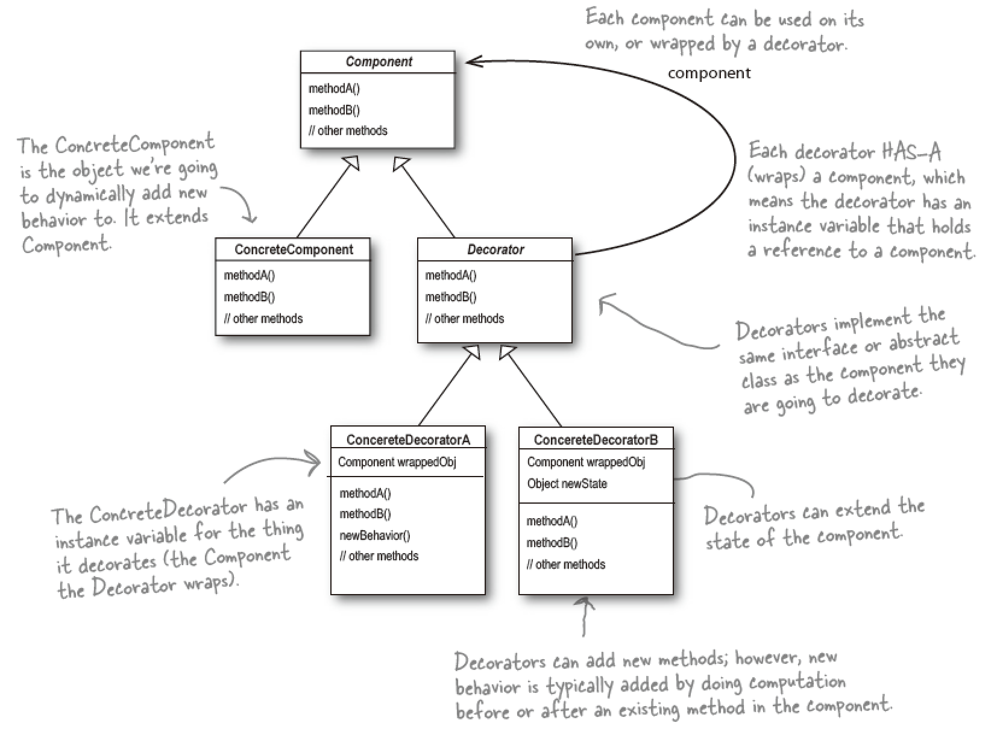
Class diagram of Decorator pattern
Decorator pattern define
Attaches additional responsibilities to an object dynamically.
Provide a flexible alternative to subclassing for extending functionality.

Slide 11
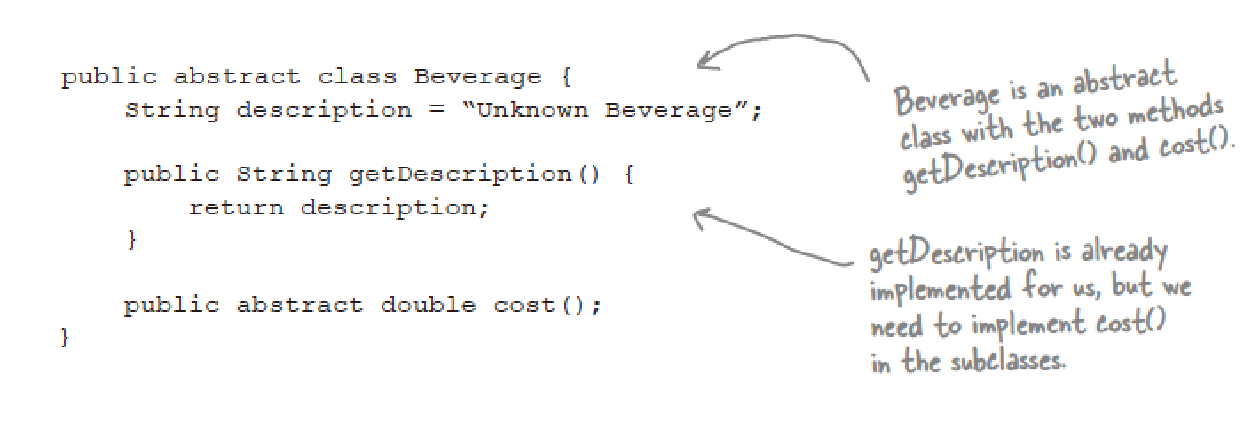
Example of components (superclass)

Slide 12
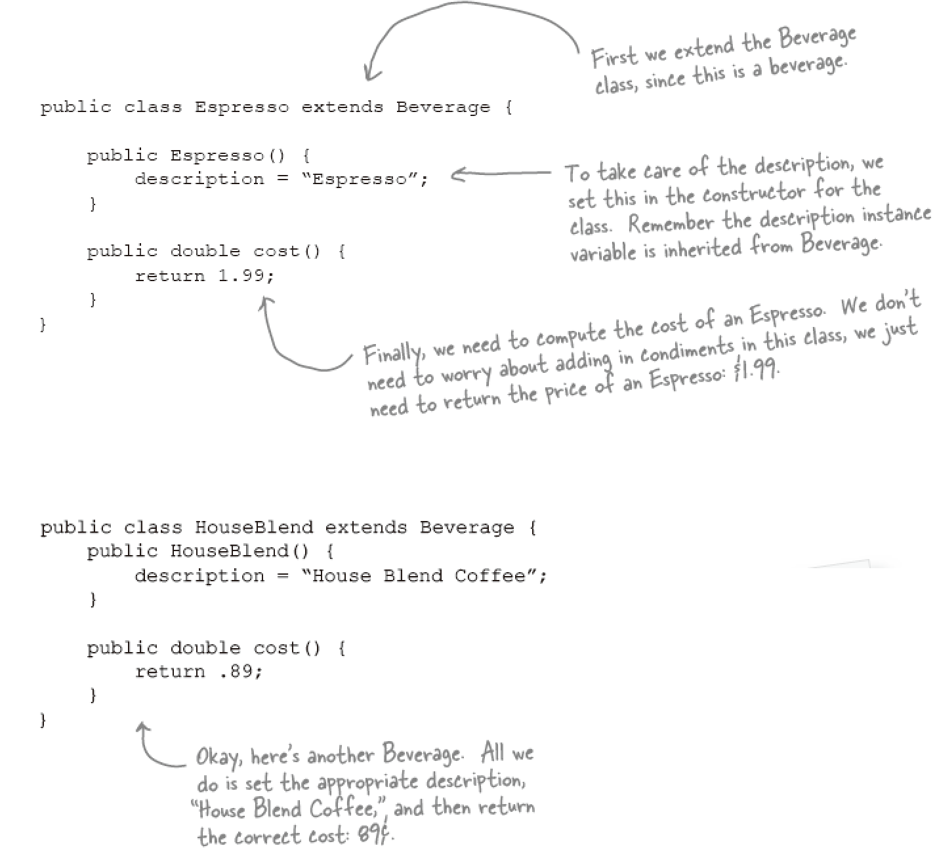
Example of components

Slide 13
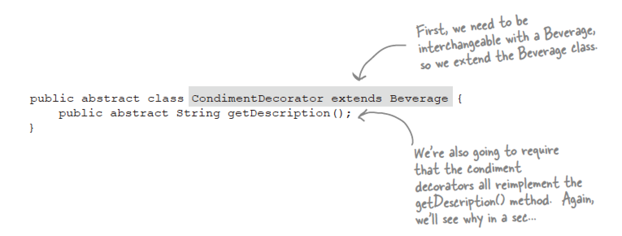
Example of decorator(superclass)

Slide 14
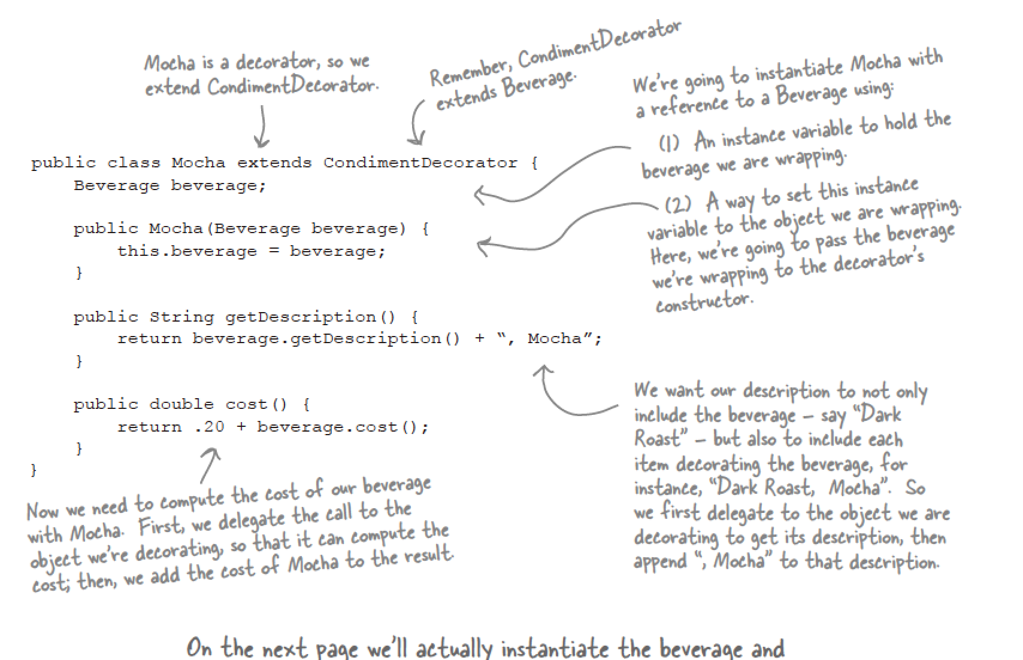
Example of decorator

Slide 15
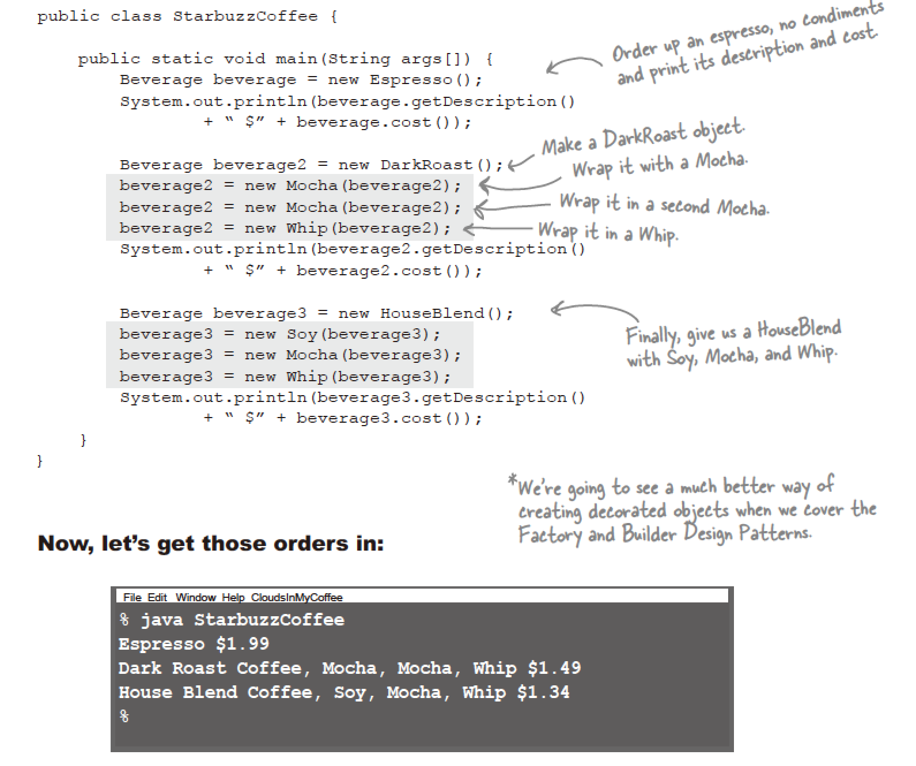
Example of main function

Slide 16
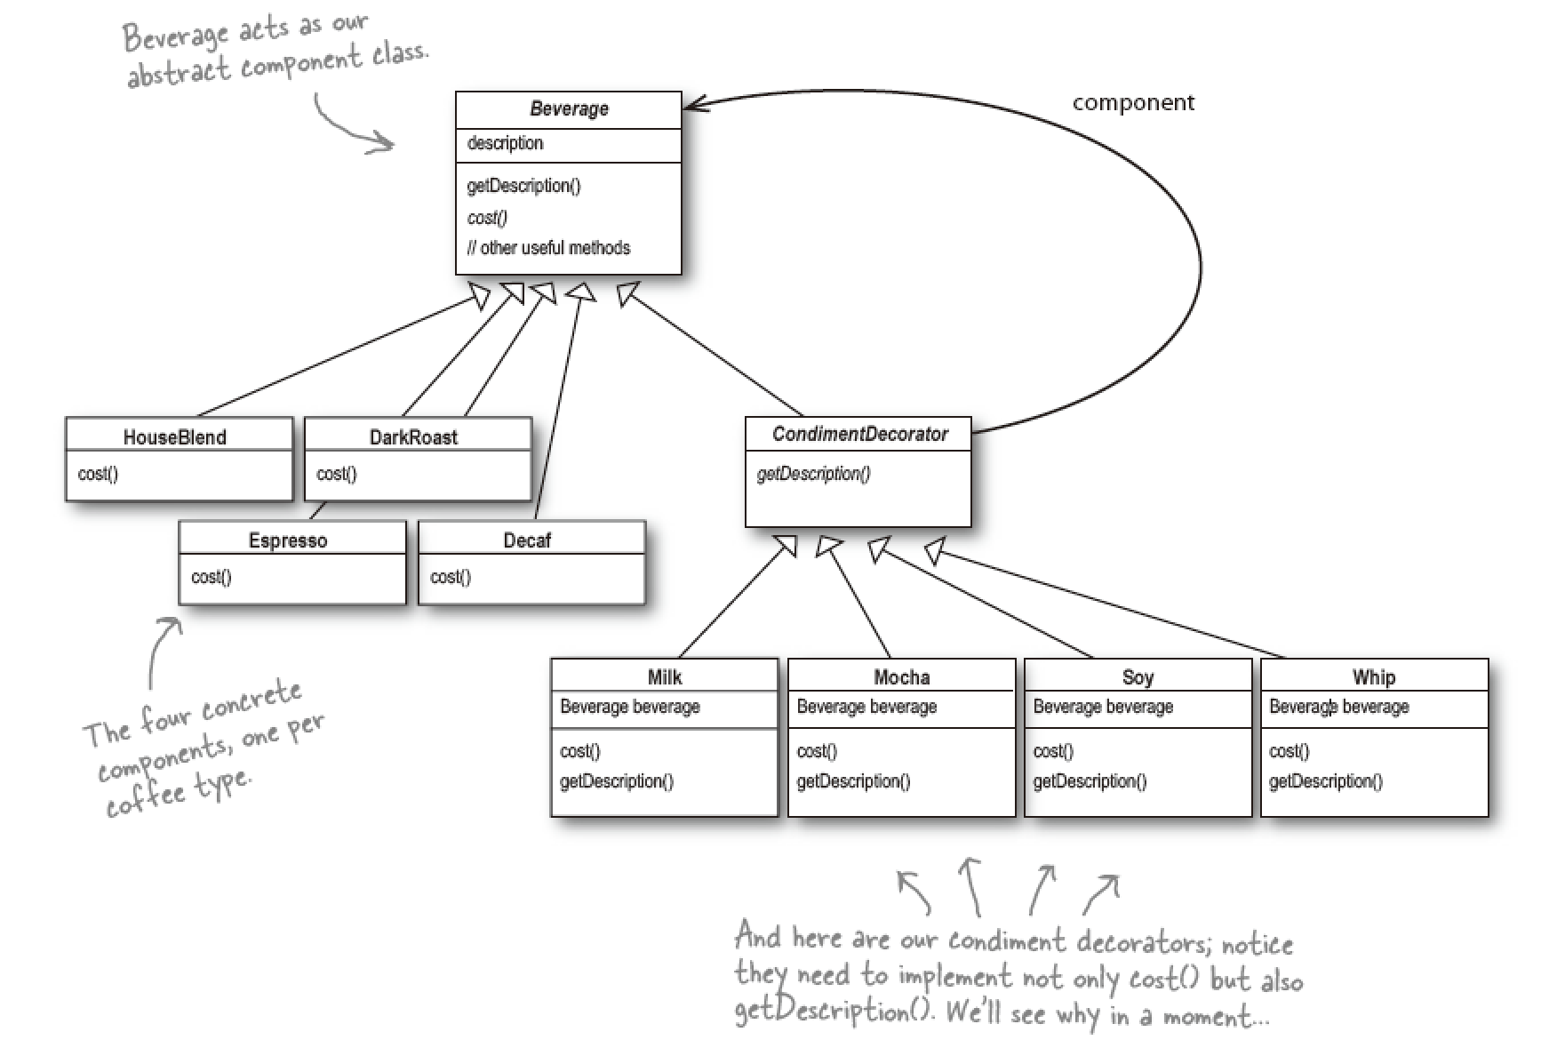
Class diagram (using decorator framework)

Slide 17
Advantage of Observer pattern
Allowing systems to be extended, even if we can’t change the underlying code.
Solution of class explosions, rigid designs, or we add functionality to the base class that isn’t appropriate for some of the subclasses.

Slide 18
More

Slide 19
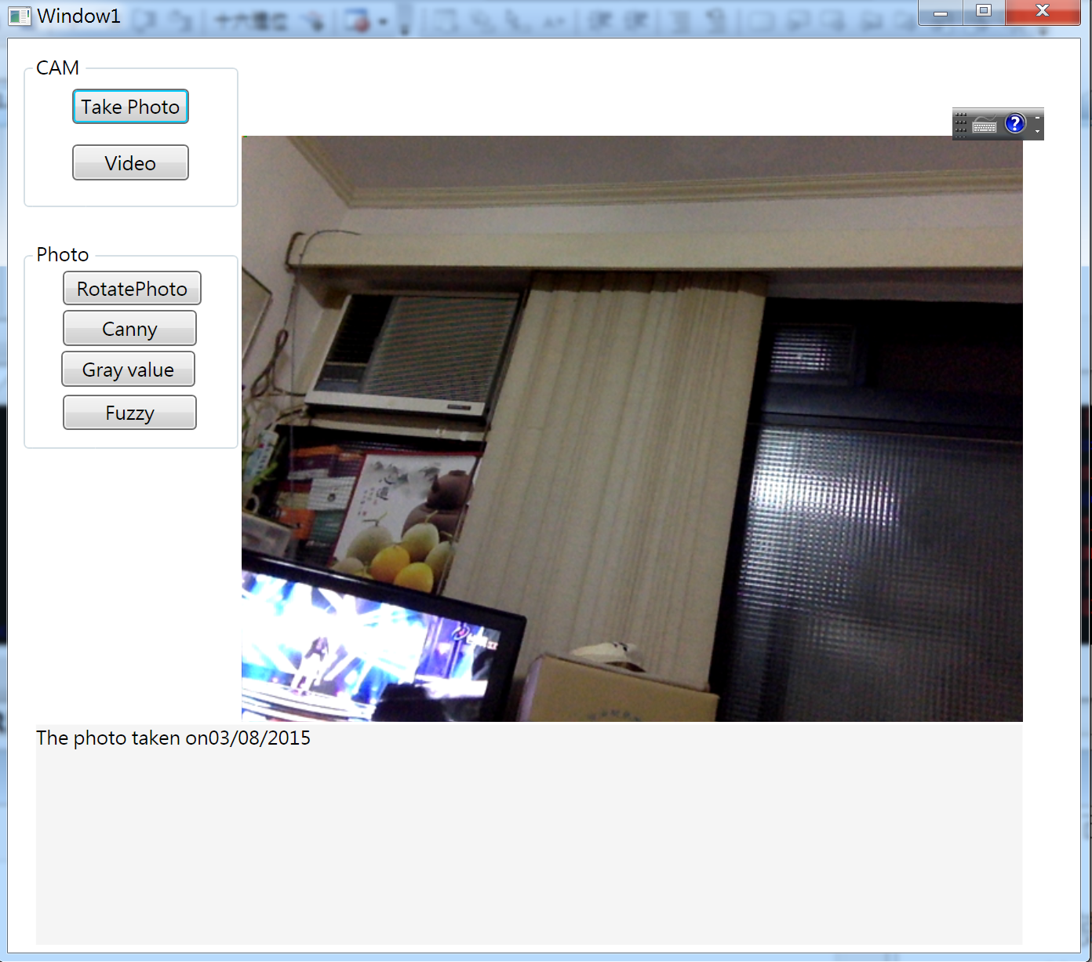
Image editor

Slide 20
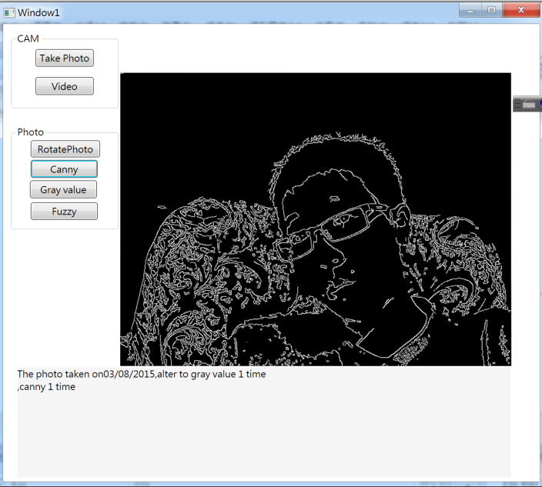
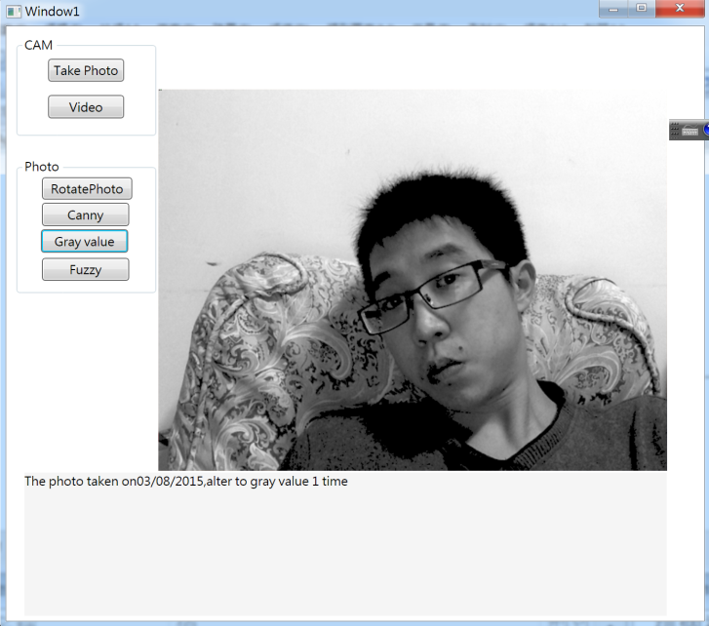
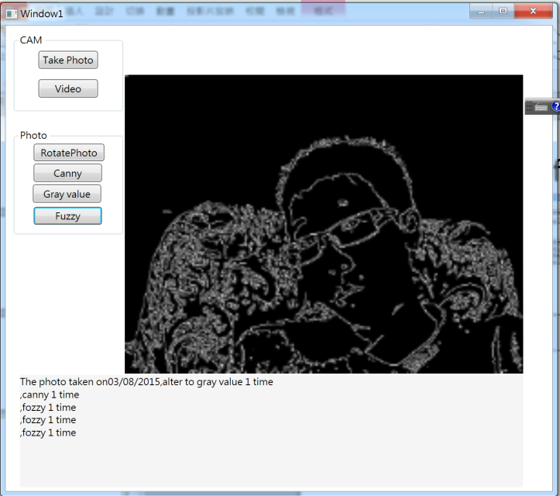
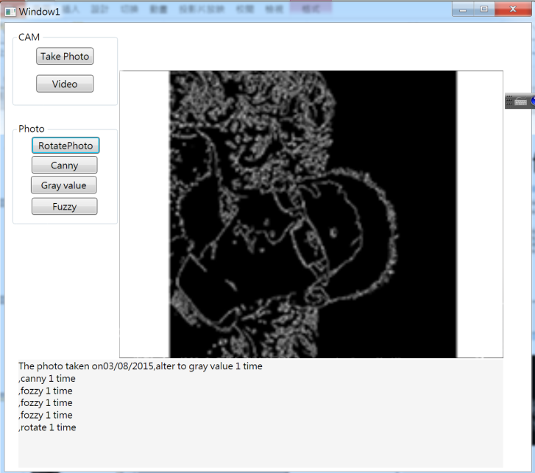
Functions of image editor

Slide 21
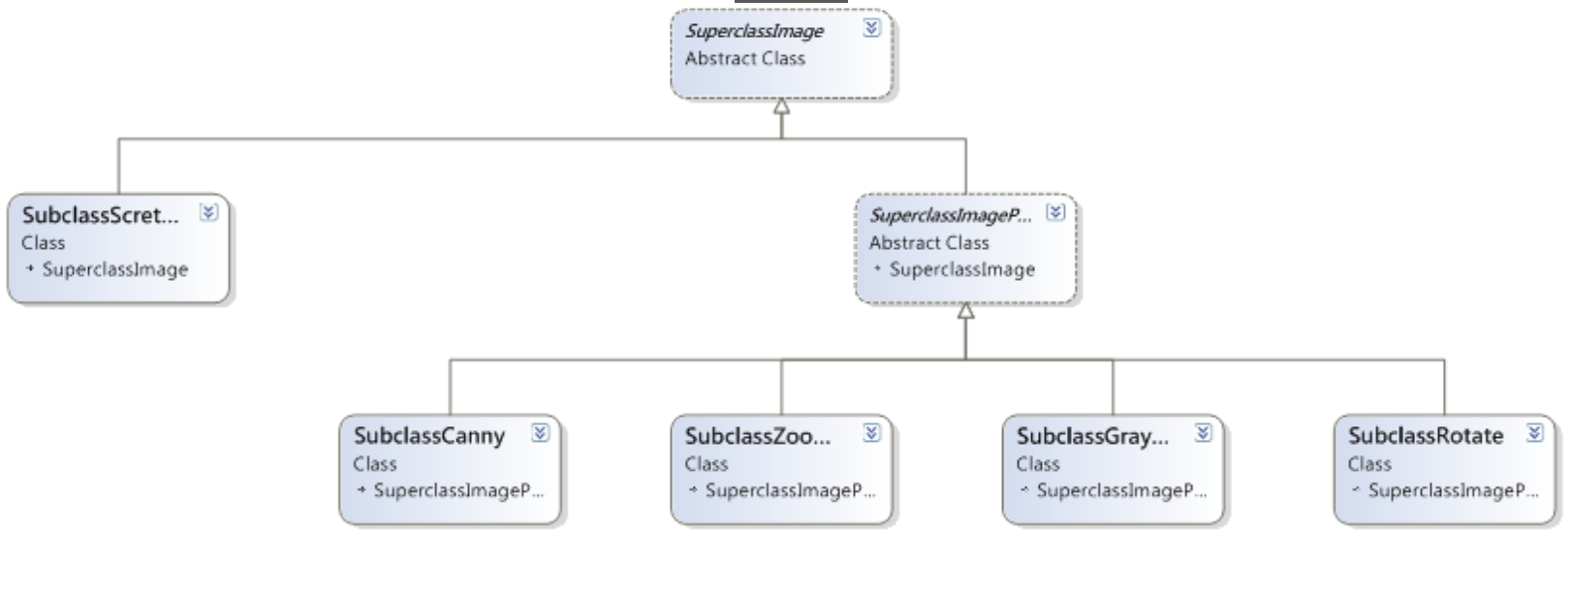
Class diagram of image editor

